Slide 1

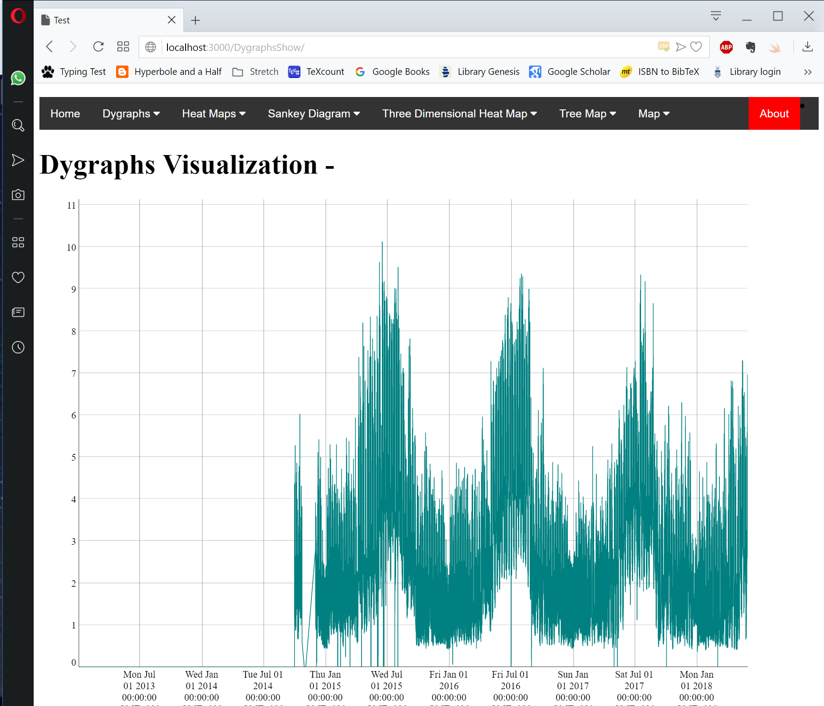


Template files
(Eg. index.html)
Jinja2
Layout
Style files
(Eg. Dygraphs.css)
HTML Page
Data
Flask
Werkzeug
(Web Server Gateway Interface)
Data
Python files
(Eg. App.py)
Input
Python
Query
Returned Data
Python Requests
OpenTSDB

